Slide 1
Species and Mechanisms of Speciation
Notes:
Species define the boundaries of independent evolutionary units

Slide 2
I. Species Definitions
Species represent the boundary for the spread of alleles and define the unit in which the modes of evolution operate
Biological Species Concept
  Individuals belong to the same species if they can interbreed with each other
Diagnostic Species Concepts
Morphospecies: individuals belong to the same
species if they share specific trait(s)
Phylogenetic Species Concept: smallest group of
monophyletic populations (diagnostic trait
are shared and derived sequences)

Slide 3
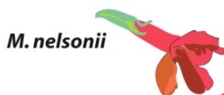

Biological Species Concept
Crossability of populations of
different species in the Monkey
Flower Species Complex
E = M. eastwoodia
R = M. rupestris
L = M. lewisii
C = M. cardinalis
V= M. verenaceus
N = M. nelsonii

Slide 4
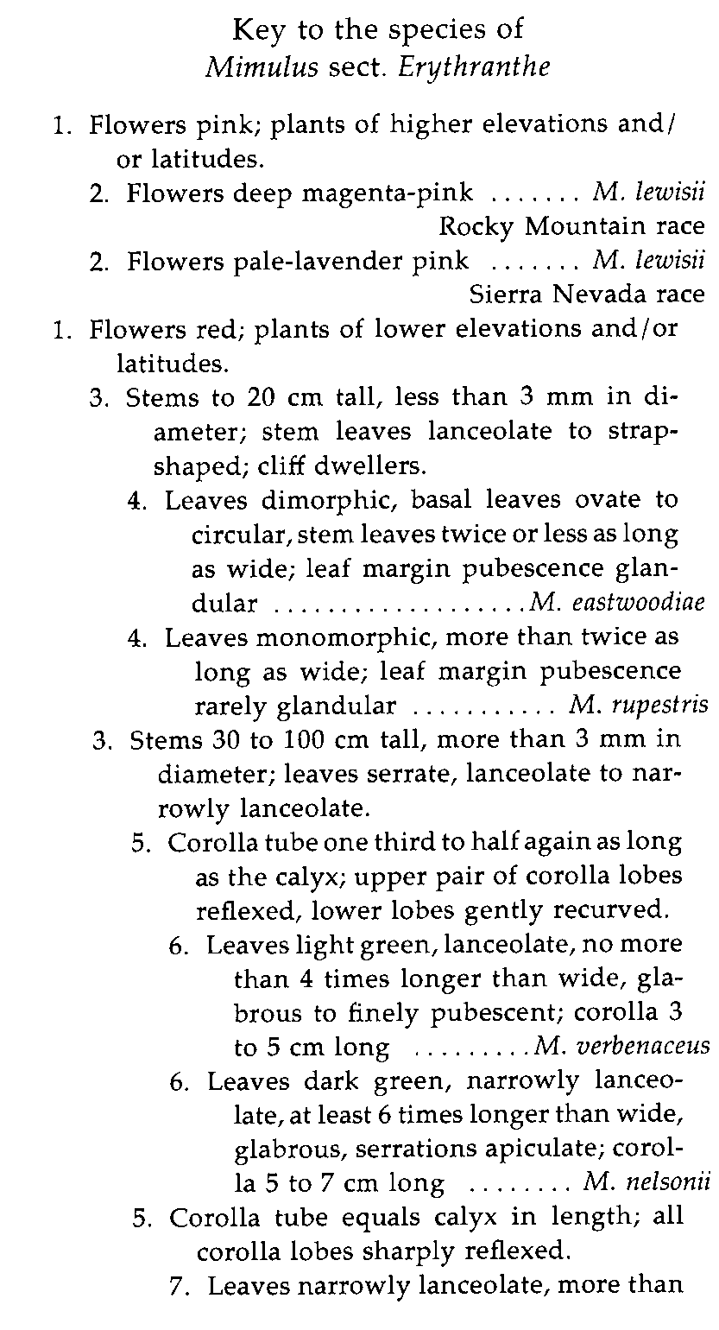
Diagnostic species concepts
Morphospecies

Slide 5
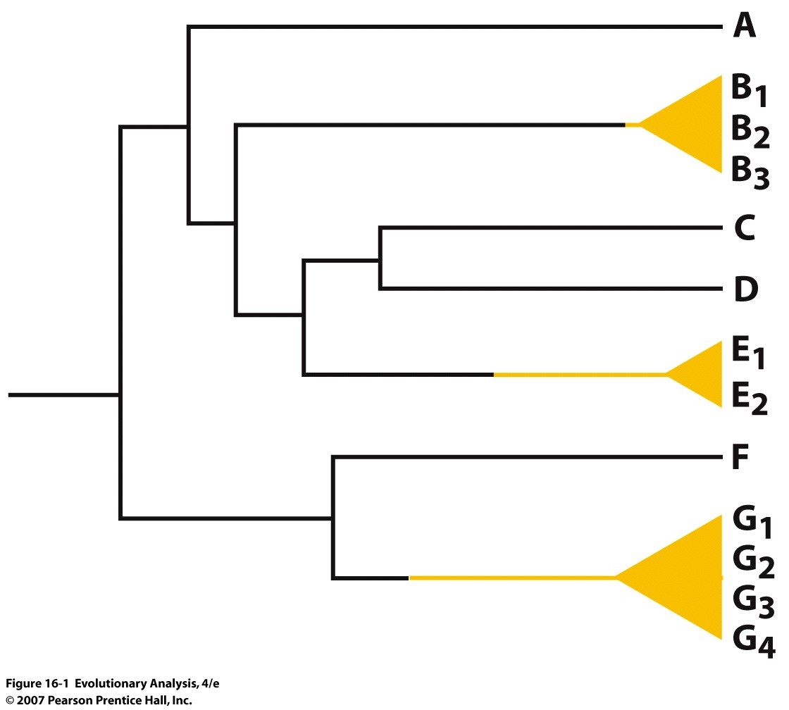
Phylogenetic species concept
Notes:
Figure 16.1 Phylogenetic species
The taxa labeled A-G on the tips of this phylogeny represent distinct species. Groups labeled G₁, G₂ etc. represent populations of the same species.
Problem is what to include and what to exclude

Slide 6
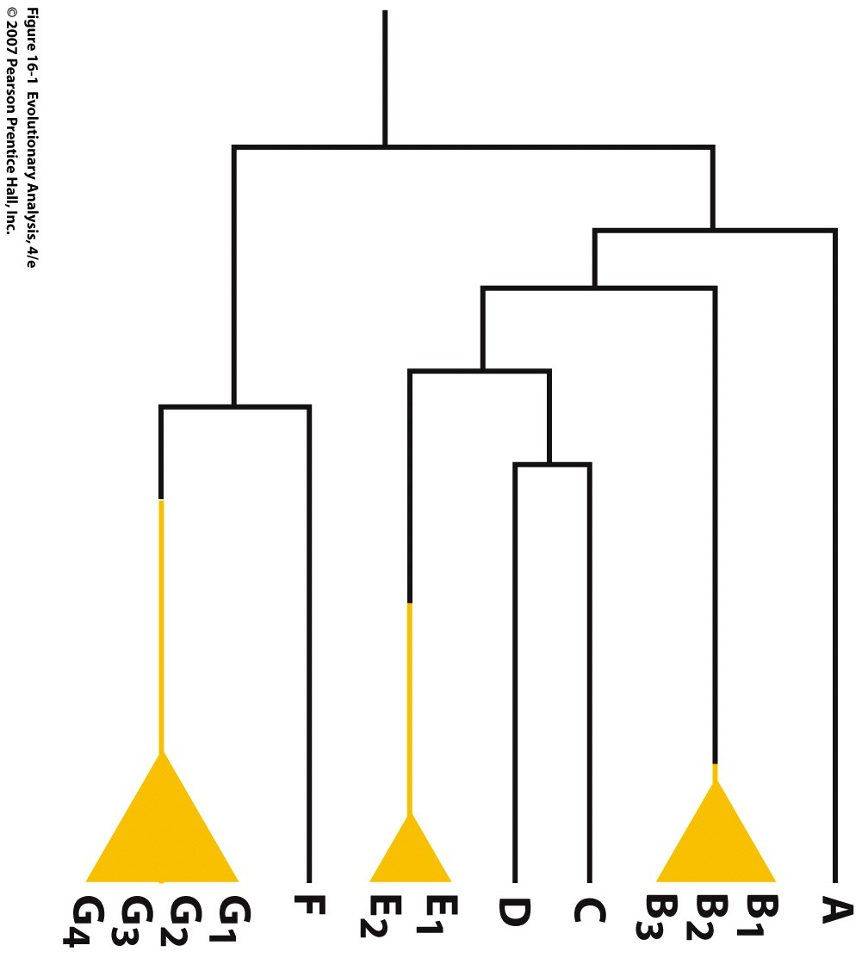
Phylogenetic species concept
Your Family Pedigree??
Notes:
Figure 16.1 Phylogenetic species
The taxa labeled A-G on the tips of this phylogeny represent distinct species. Groups labeled G₁, G₂ etc. represent populations of the same species.
Problem is what to include and what to exclude

Slide 7
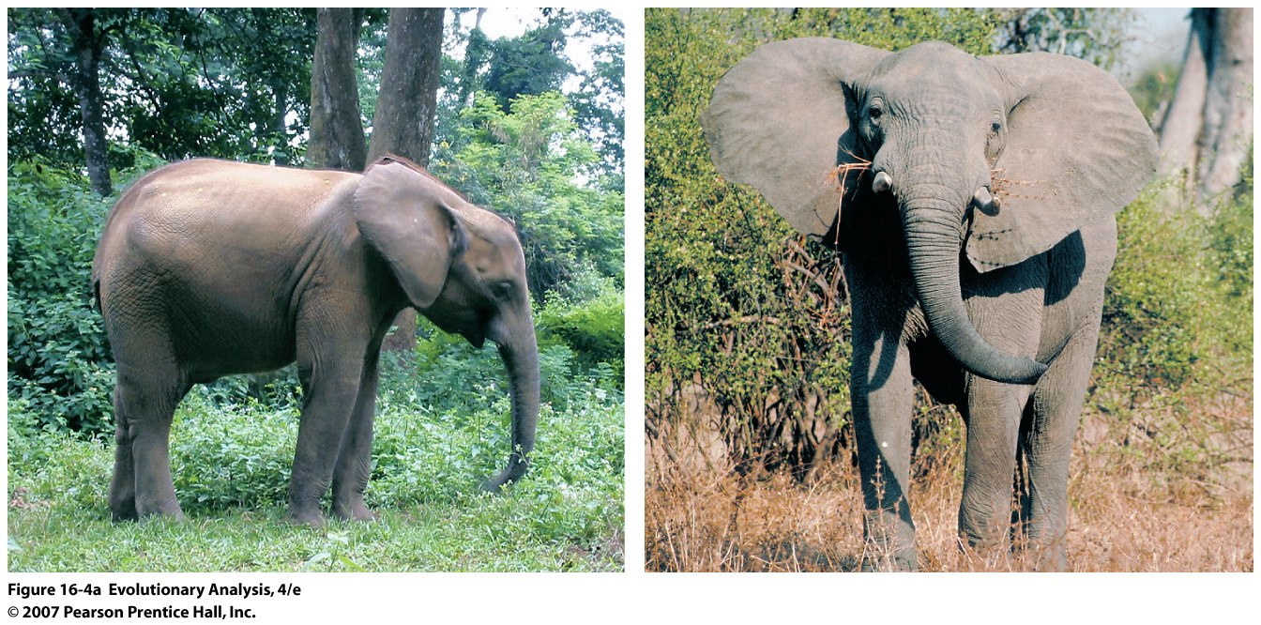
Forest versus savanna elephants
Notes:
Figure 16.4a Elephant diversity
In West Africa, elephants that live in forest habitats (left) have morphological characteristics that distinguish them from savanna-dwelling elephants (right) from west, central, and east Africa.
Forest elephants: Physical differences include a longer, narrower jaw, rounded ears and smaller body size. While a male savanna elephant grows to be about 10 feet tall, a male forest elephant rarely reaches a height of 8 feet.

Slide 8
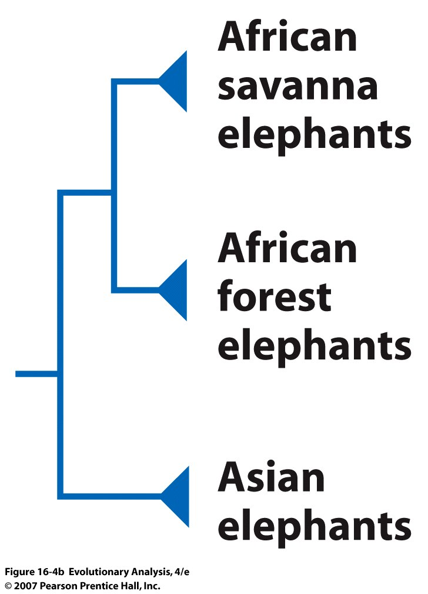
Notes:
Figure 16.4b Elephant diversity
(b) This evolutionary tree indicates that forest-dwelling elephants are a distinct phylogenetic species.

Slide 9
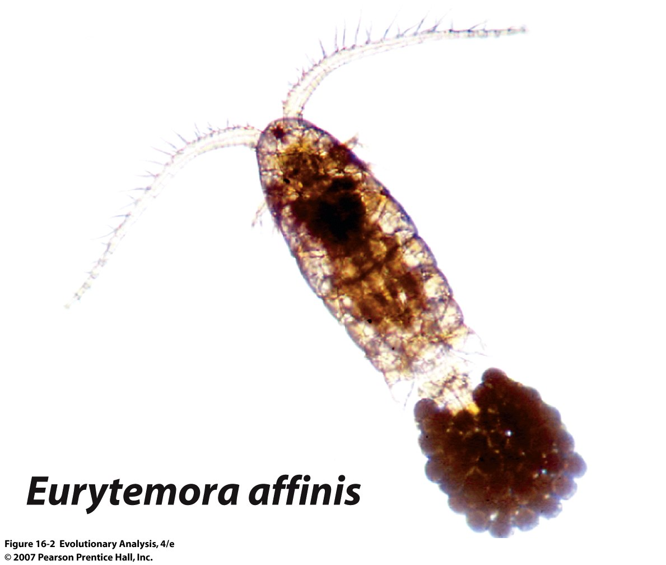
An example of using PSC and BSC
Notes:
Figure 16.2 A cosmopolitan copepod
Eurytemora affinis is a common inhabitant of coastal environments throughout the world.

Slide 10
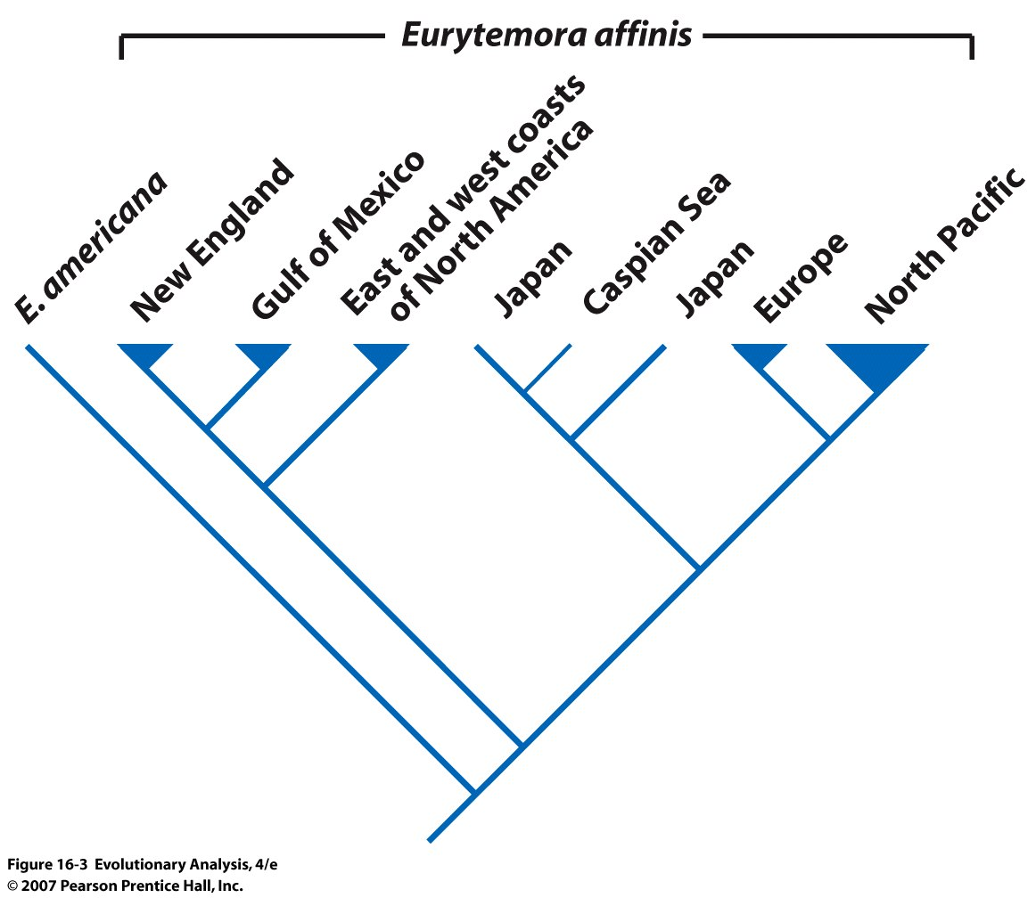
X
X
X
X
X
X
x = not able to
mate
Conclusion:
BSC and PSC are congruent
Notes:
Figure 16.3 Copepod diversity
A phylogeny of E. affinis populations shows that at least eight phylogenetic species exist, each in a different geographic area.

Slide 11
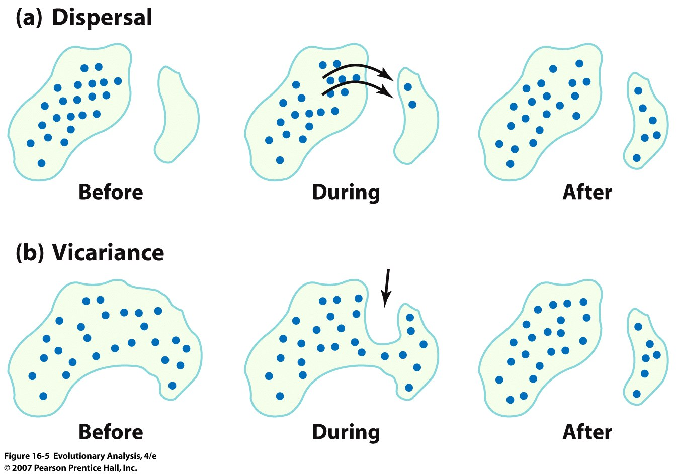
III. Origins of Species:
A. Allopatry: physical isolation becomes a barrier to gene flow
(development of a natural barrier)
Notes:
Steps of Speciation
Isolation, divergence of habitat use, or development of RI features, but more complex as we will see, isolation not necessary
Figure 16.5 Isolation by dispersal and vicariance
In the diagram of dispersal (a), the arrows indicate movement of individuals. In the diagram of vicariance (b), the arrows indicate an encroaching physical feature such as a river, glacier, lava flow, or new habitat.

Slide 12
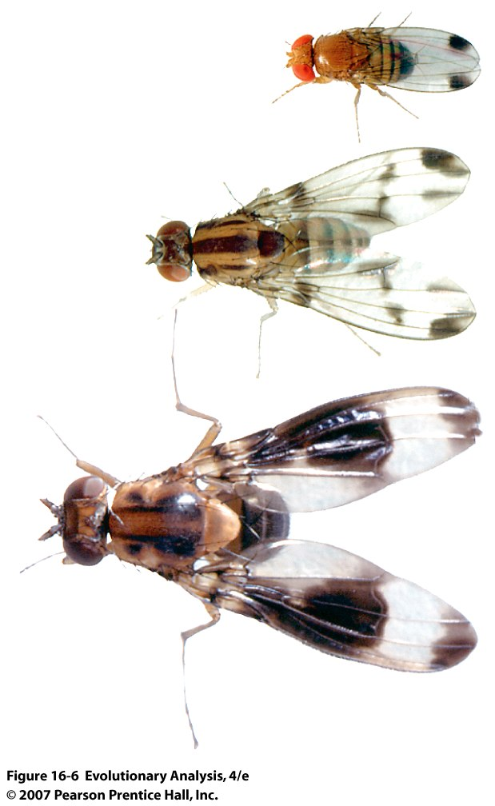
Hawaiian Drosophila
Notes:
Figure 16.6 Hawaiian Drosophila
As these photos of Drosophila suzukii, D. macrothrix, and D. nigribasis (top to bottom) show, the Drosophila found in Hawaii are remarkably diverse in body size, wing coloration, and other traits.

Slide 13
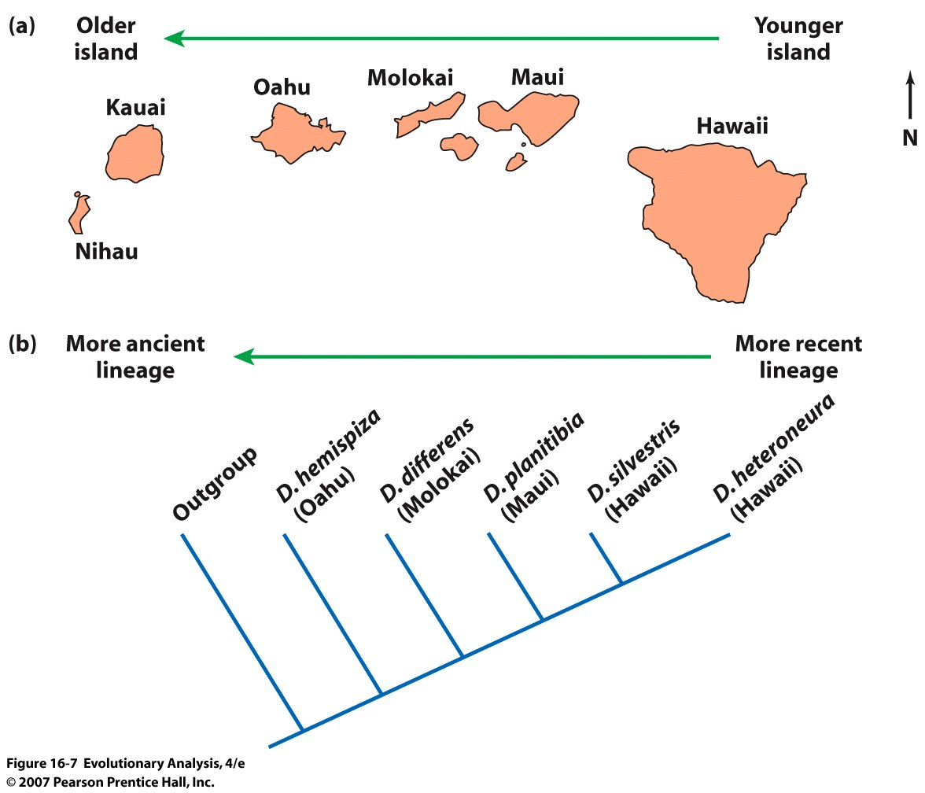
Evidence for speciation by dispersal and colonization events
The five Drosophila species on the tree are a closely related group
Notes:
Figure 16.7 Evidence for speciation by dispersal and colonization events
(a) The Hawaiian islands are part of an archipelago that stretches from the island of Hawaii to the Emperor Seamounts near Siberia. The youngest landform in the chain is the island of Hawaii, which still has active volcanoes. (b) The five Drosophila species on the tree are a closely related group. Note that the older-to-younger sequence of branches on the phylogeny corresponds to the older-younger sequence of island formation shown in part (a). This pattern is consistent with the hypothesis that at least some of the speciation events in this group were the result of island hopping. See Bonacum et al. (2005).

Slide 14
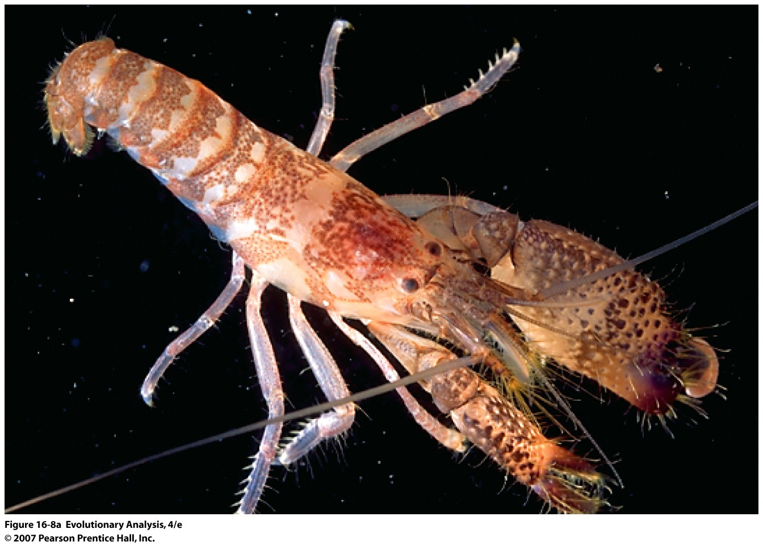
Snapping shrimp speciated due to vicariance
Notes:
Figure 16.8a Snapping shrimp speciated due to vicariance
(a) This is Alpheus malleator, found on the Pacific side of the Panamanian isthmus.

Slide 15
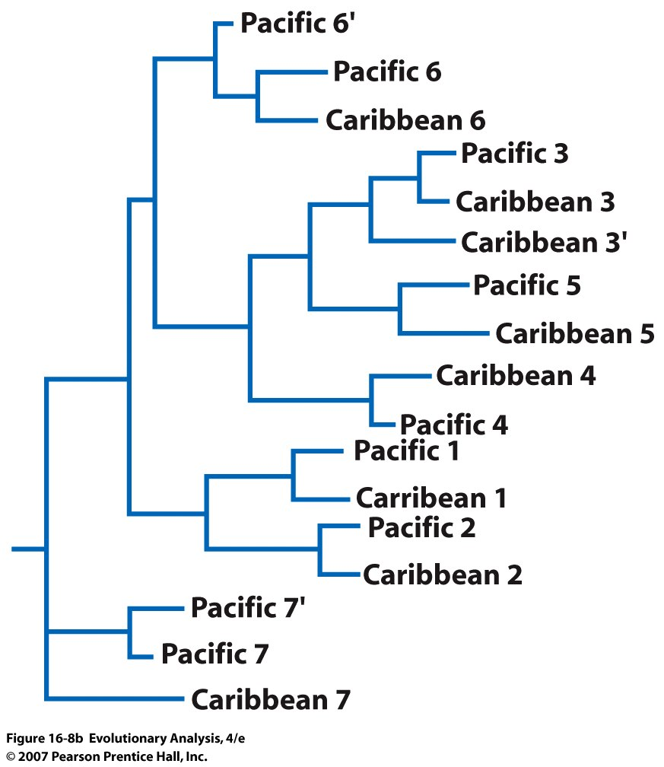
Notes:
Discuss Branch Lengths
Figure 16.8b Snapping shrimp speciated due to vicariance
(b) This tree of unnamed species was estimated from sequence divergence in mitochondrial DNA. Reprinted with permission from Knowlton et al. (1993). Morphological sister species are numbered and identified by location. The prime marks after some letters indicate cryptic species distinguished by sequence differences. In every case, the putative sister species are indeed each others' closest relative.

Slide 16
B. Sympatric Speciation
Barriers to gene flow arise at a very local scale, often due to fine scale local environmental adaptation. Populations are not geographically isolated
Speciation occurs through disruptive natural selection

Slide 17
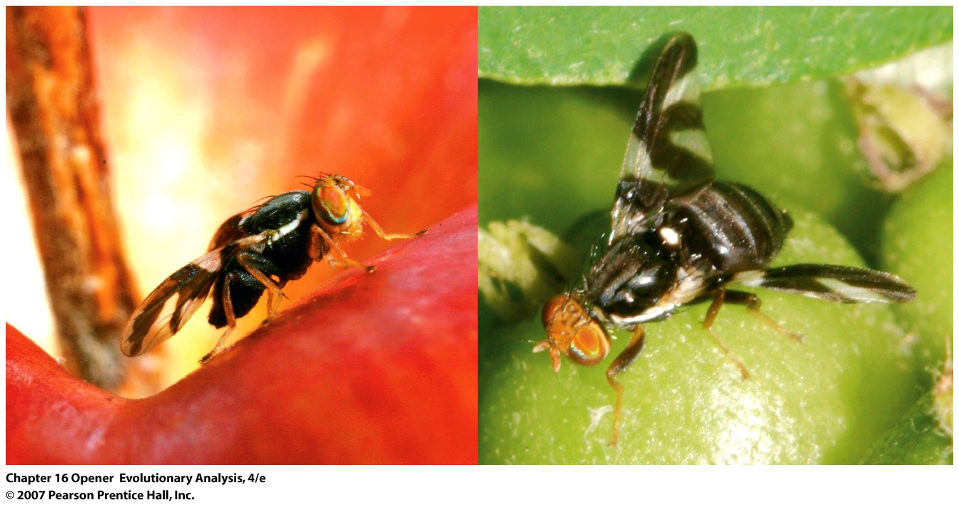
Rhagoletis pomonella populations are diverging into species that are specialized for parasitizing fruits of apple (left) versus hawthorn (right)
Notes:
Do you need allopatry for speciation??
In North America, Rhagoletis pomonella populations are diverging into species that are specialized for parasitizing fruits of apple (left) versus hawthorn (right). They are just one example where biologists are documenting speciation in nature.

Slide 18
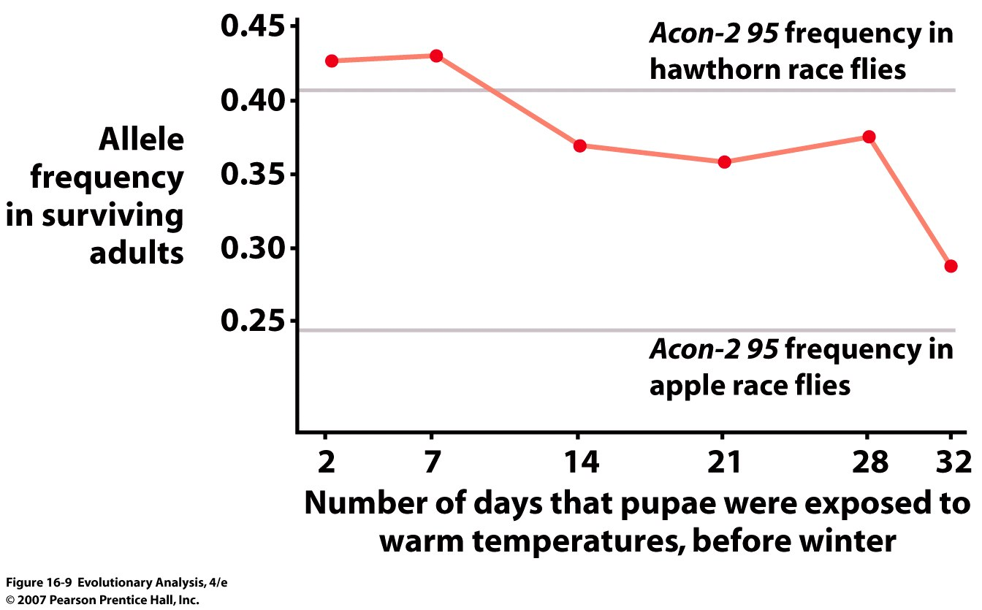
Conclusion:
Natural selection is responsible for divergence even
with extensive gene flow
Notes:
Figure 16.9 Allele frequency changes caused by differences in temperatures experienced by apple maggot flies
This graph plots the frequencies of an allele called Acon-2 95 in populations of hawthorn maggot fly pupae that survived to emerge as adults, as a function of the number of days of warm temperatures the pupae experienced. In the population that experienced an extended period of warm days—similar to the regime experienced by apple flies in nature—allele frequencies approximated those observed in natural populations of apple flies. From Feder et al. (1997).
6 Allozyme Loci in 3 areas of the genome are differentiated. Expt stared with hawthorn race flies

Slide 19
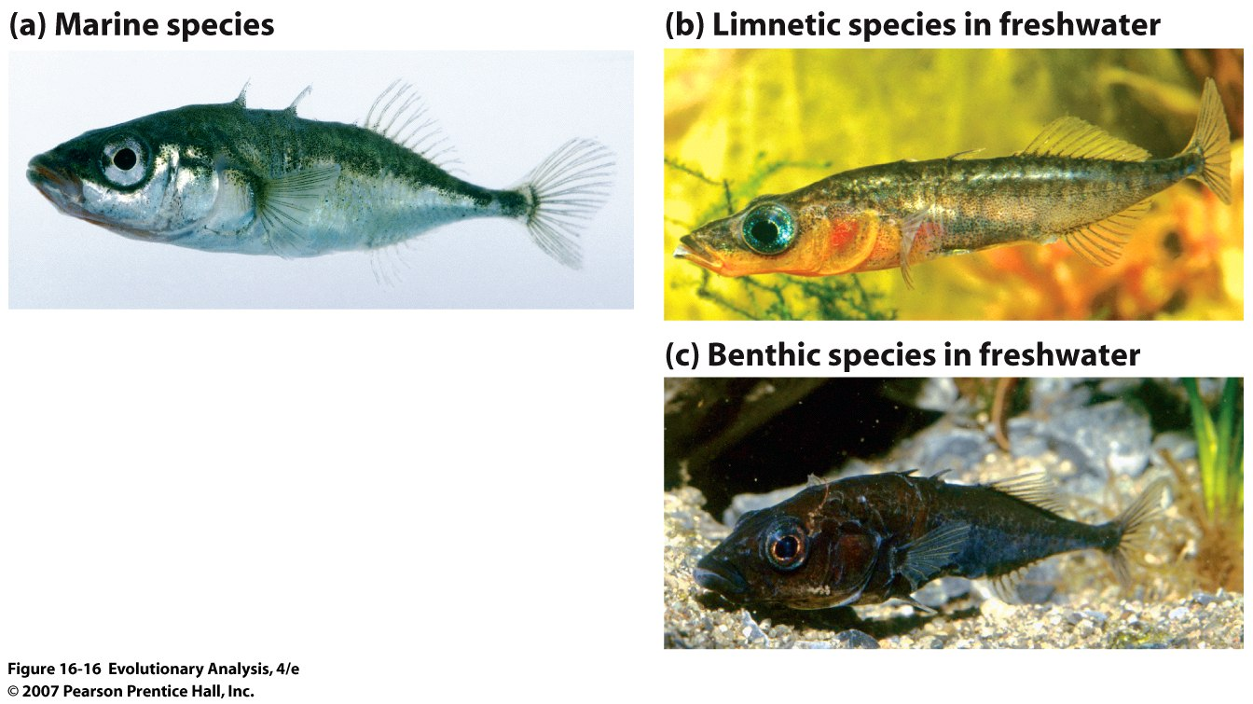
Speciation in threespine sticklebacks
Open water
Shore line
Notes:
Figure 16.16 Speciation in threespine sticklebacks
Long and thin allow escape from trout
(a) Stickleback populations that occupy marine environments are large and have prominent spines along their dorsal side. (b) Stickleback species that live in limnetic or open-water lake habitats consist of individuals that are small and slim with relatively large eyes and spines. (c) Lake populations that occupy benthic habitats near the shores of a lake consist of larger, deeper-bodied individuals.

Slide 20
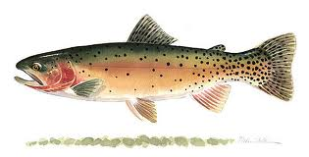
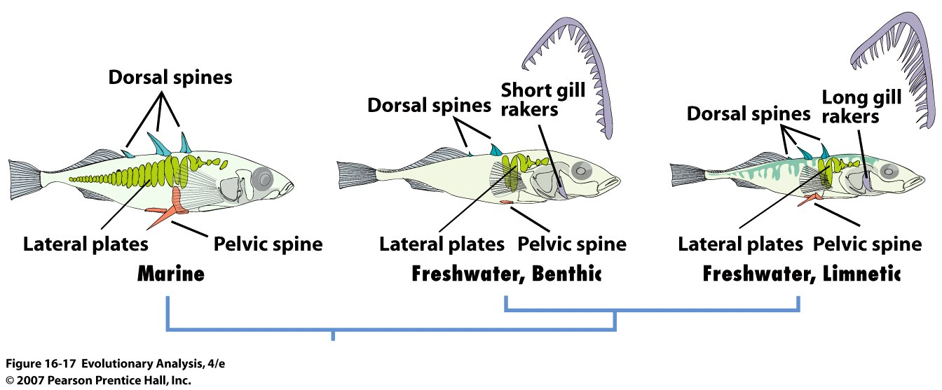
CutThroat Trout
Open water feeders
Limnetic mates preferentially with Limnetic
Benthic mates preferentially with Benthic
Hybirds have lower fitness than parents
Notes:
Figure 16.17 Morphological characters that vary among stickleback species
These drawings detail the traits that vary between marine and freshwater sticklebacks, and between the limnetic and benthic sticklebacks found in freshwater. The key traits are the size of gill rakers, and the size and extent of the dorsal spines, lateral plates, and pelvic girdle and pelvic spines. After Schluter (1993); Peichel et al. (2001); Cole et al. (2003); Peichel (2005); Craig Miller (personal communication).
Assoratively mate, hybrids have fitness than eitehr parentl form, all in about 15000 years

Slide 21
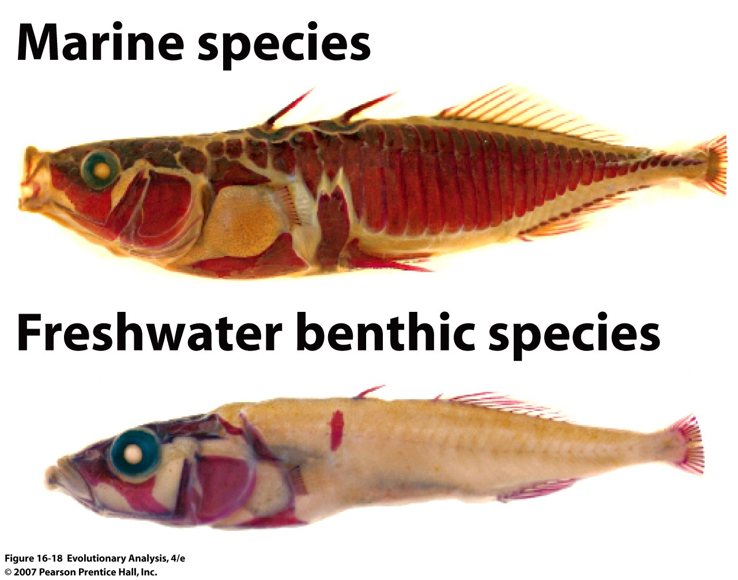
Notes:
Figure 16.18 Marine and freshwater sticklebacks: Contrasts in extent of lateral plates
These fish have been stained with the dye alizarin-red, which highlights bony tissues.

Slide 22
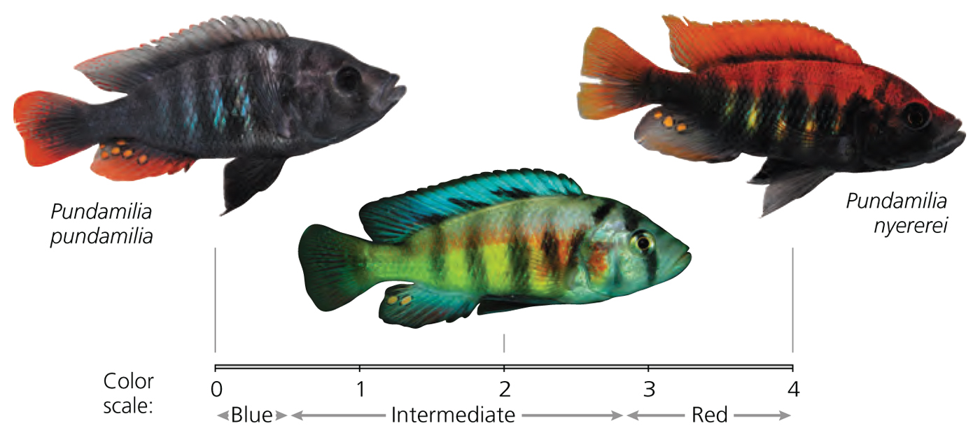
Assortative mating reflects Natural Selection

Slide 23
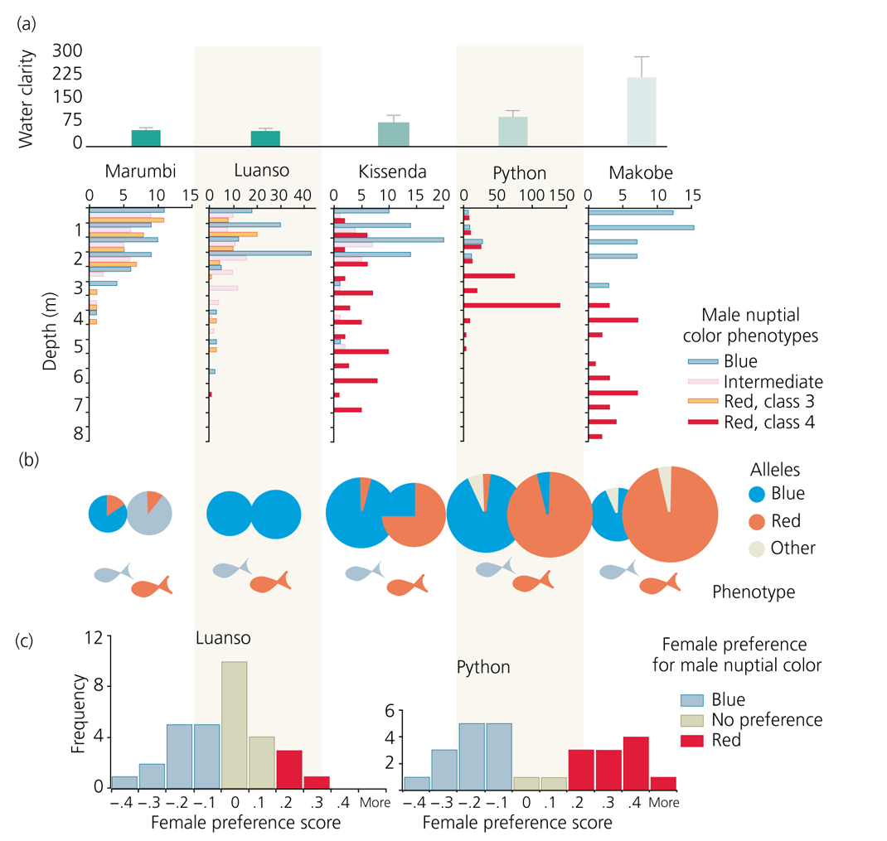

Slide 24
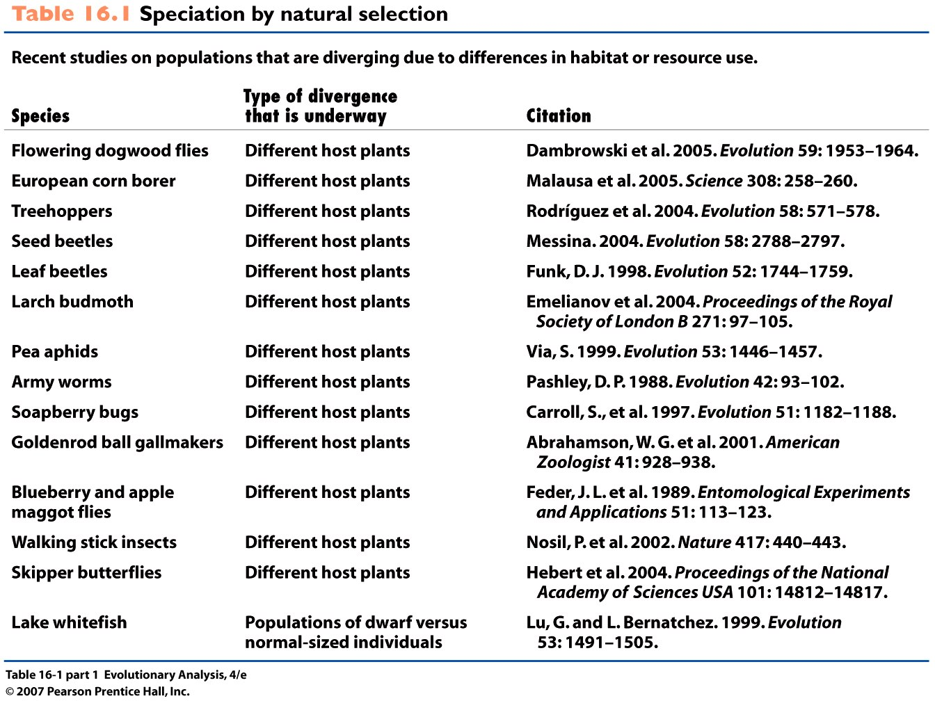
Notes:
Table 16.1 (part 1) Speciation by natural selection

Slide 25
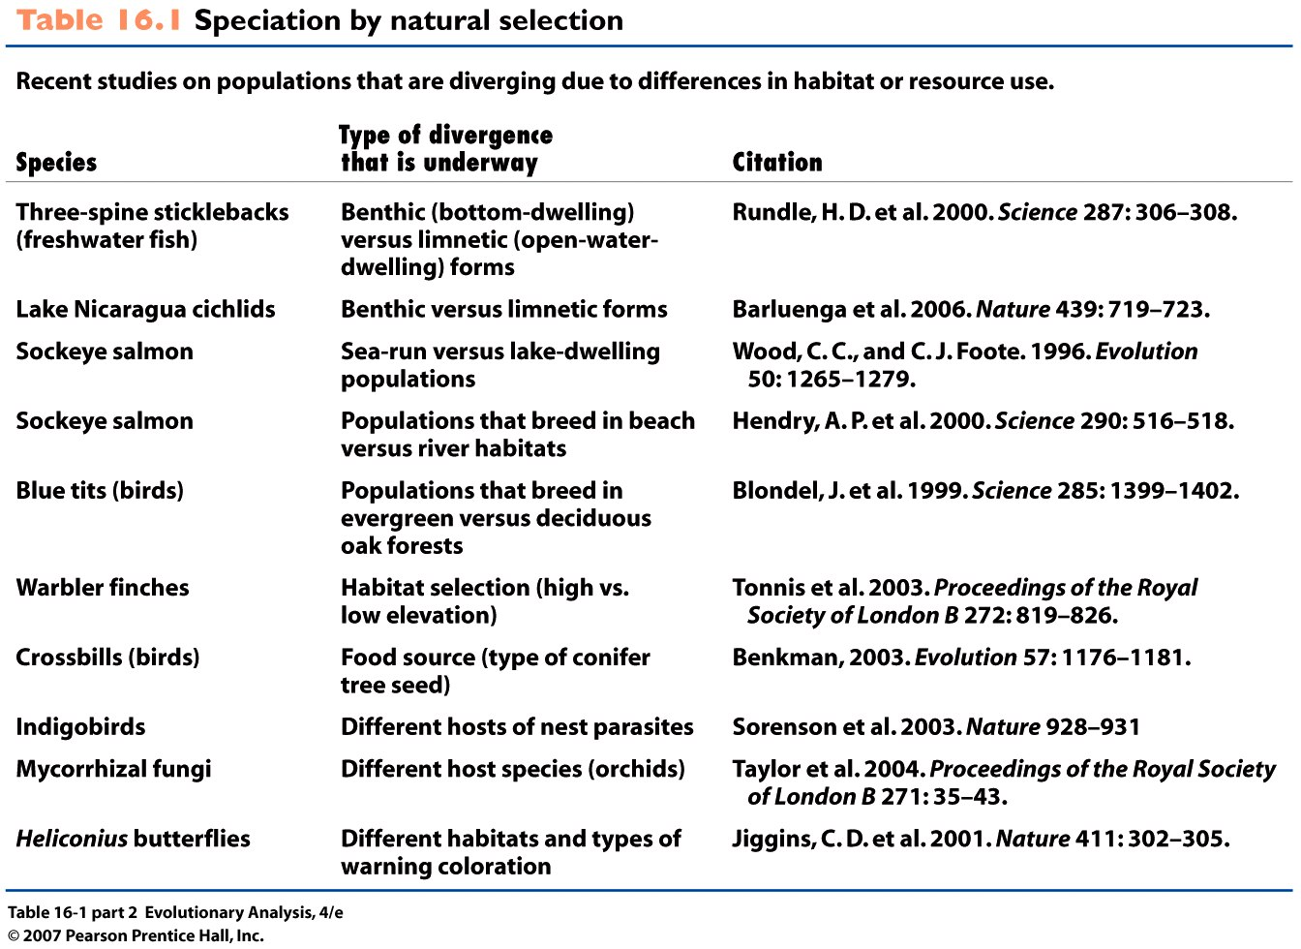
Notes:
Table 16.1 (part 2) Speciation by natural selection

Slide 26
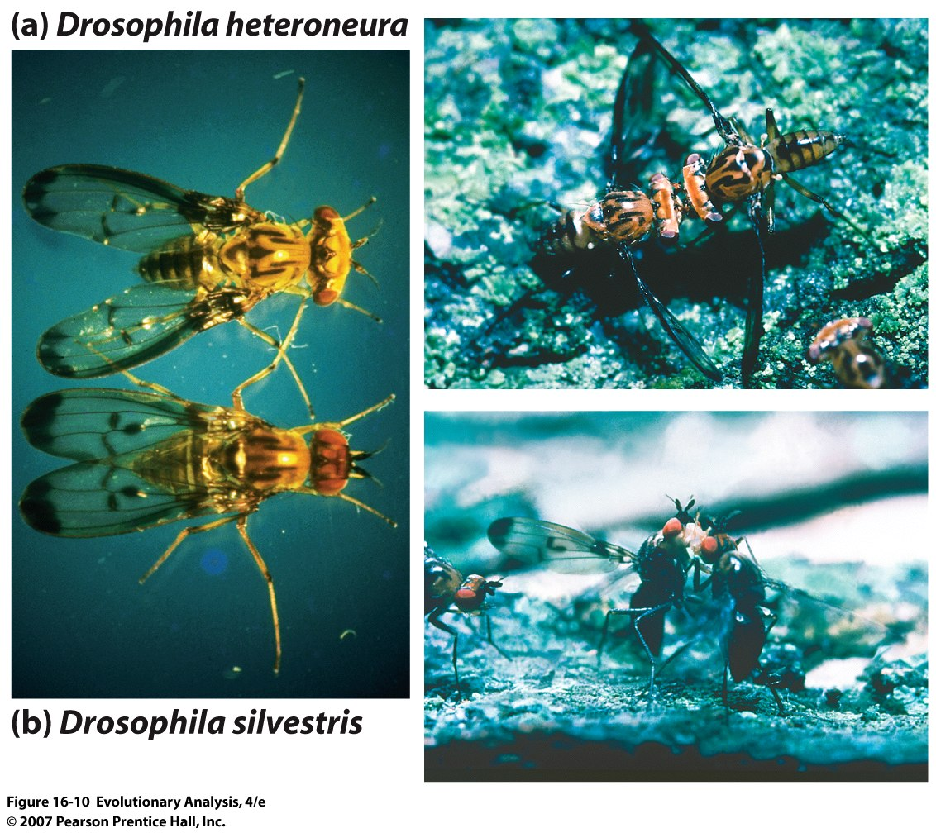
C. Sexual Selection
Notes:
Figure 16.10 Contrasting head shapes and fighting strategies in Hawaiian Drosophila
(a) Male Drosophila heteroneura have wide heads; male Drosophila silvestris have narrow heads. (b) D. heteroneura establish display territories on a lek by butting heads;. D. silvestris fight over display territories by rearing up and grappling with one another.

Slide 27
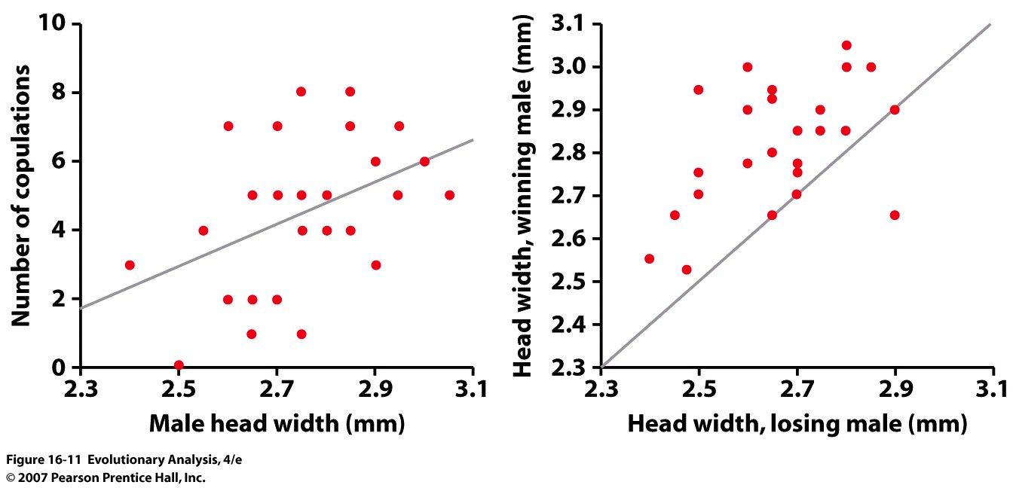
Evidence for sexual selection on head width in Drosophila heteroneura
Notes:
Figure 16.11 Evidence for sexual selection on head width in Drosophila heteroneura
The graph on the left shows the number of copulations achieved by male Drosophila heteroneura when paired with a series of different females, as a function of their head width. The best-fit line indicates that there is a positive relationship between copulation success and head width. The graph on the right compares the head width of winning versus losing males in staged contests. The straight line divides the plot into sections indicating that the wider-headed male won (upper left half) or the narrower-headed male won (lower right half). From Boake et al. (1997).

Slide 28
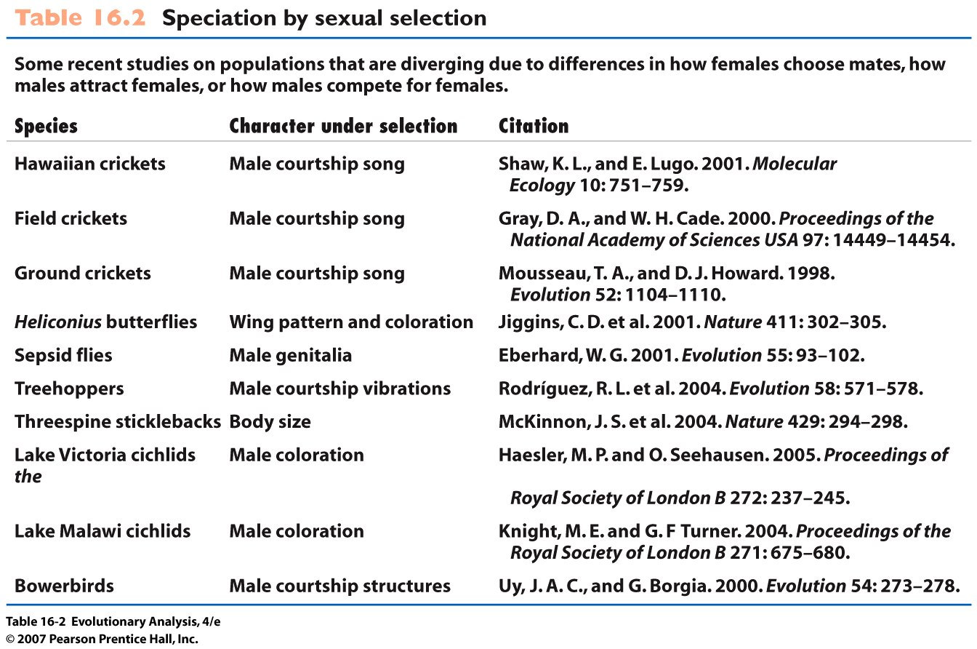
Notes:
Table 16.2 Speciation by sexual selection

Slide 29
D. Other sources:
Chromosomal mutations
Drift
Polyploidy

Slide 30
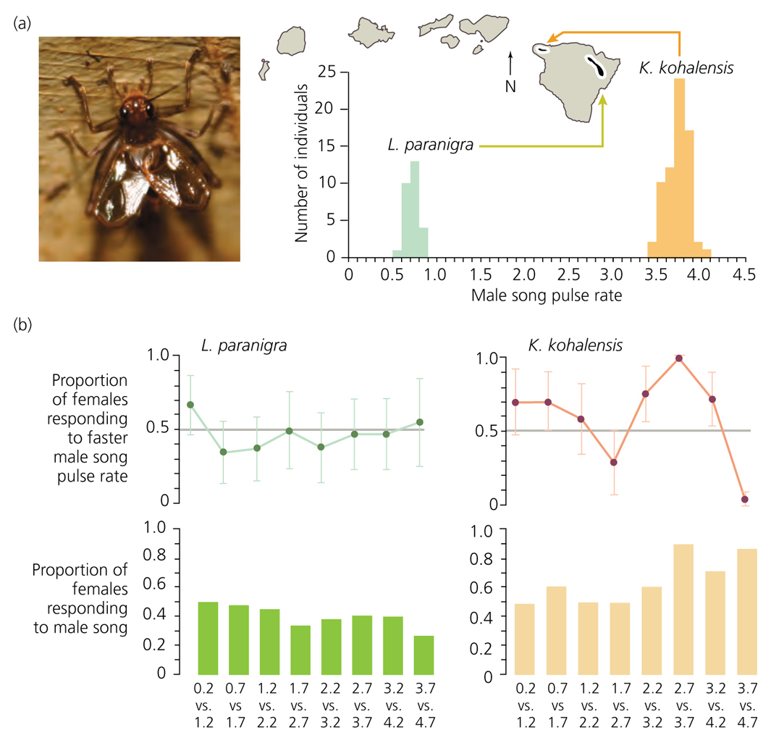
Hawaiian Crickets (Perhaps Drift)

Slide 31
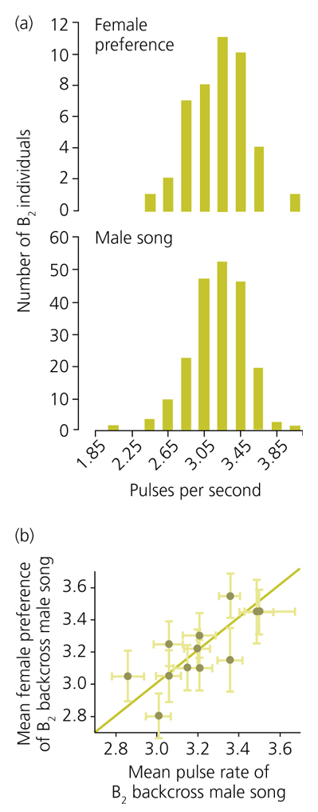

Slide 32
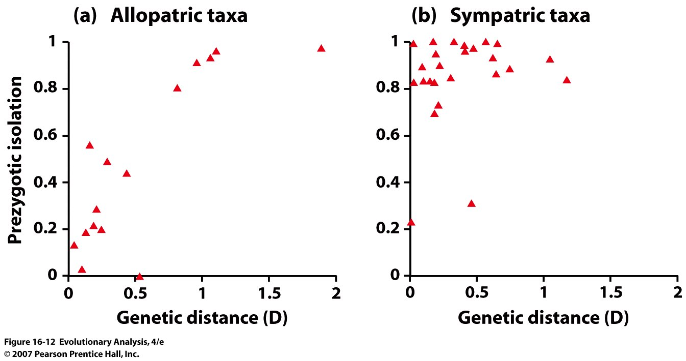
IV. The evolution of isolating barriers
Prezygotic isolation and reinforcement
Prezygotic isolation: Reproductive isolation resulting in prevention
of fusion of gametes from different species
Reinforcement: Selection that reduces the frequency of hybrids
Notes:
Discuss outcome of secondary contact
Figure 16.12 Prezygotic isolation in allopatric versus sympatric species pairs of Drosophila
These graphs (Coyne and Orr 1997) plot degree of prezygotic isolation versus genetic distance in a variety of sister-species pairs from the genus Drosophila. Prezygotic isolation is estimated from mate-choice tests performed in the laboratory. A value of 0 indicates that different populations freely interbreed (0% prezygotic isolation) and 1 indicates no interbreeding (100% prezygotic isolation). Genetic distance is estimated from differences in allele frequencies found in allozyme surveys. Sibling species with the same degree of overall genetic divergence show much more prezygotic isolation if they live in sympatry.

Slide 33
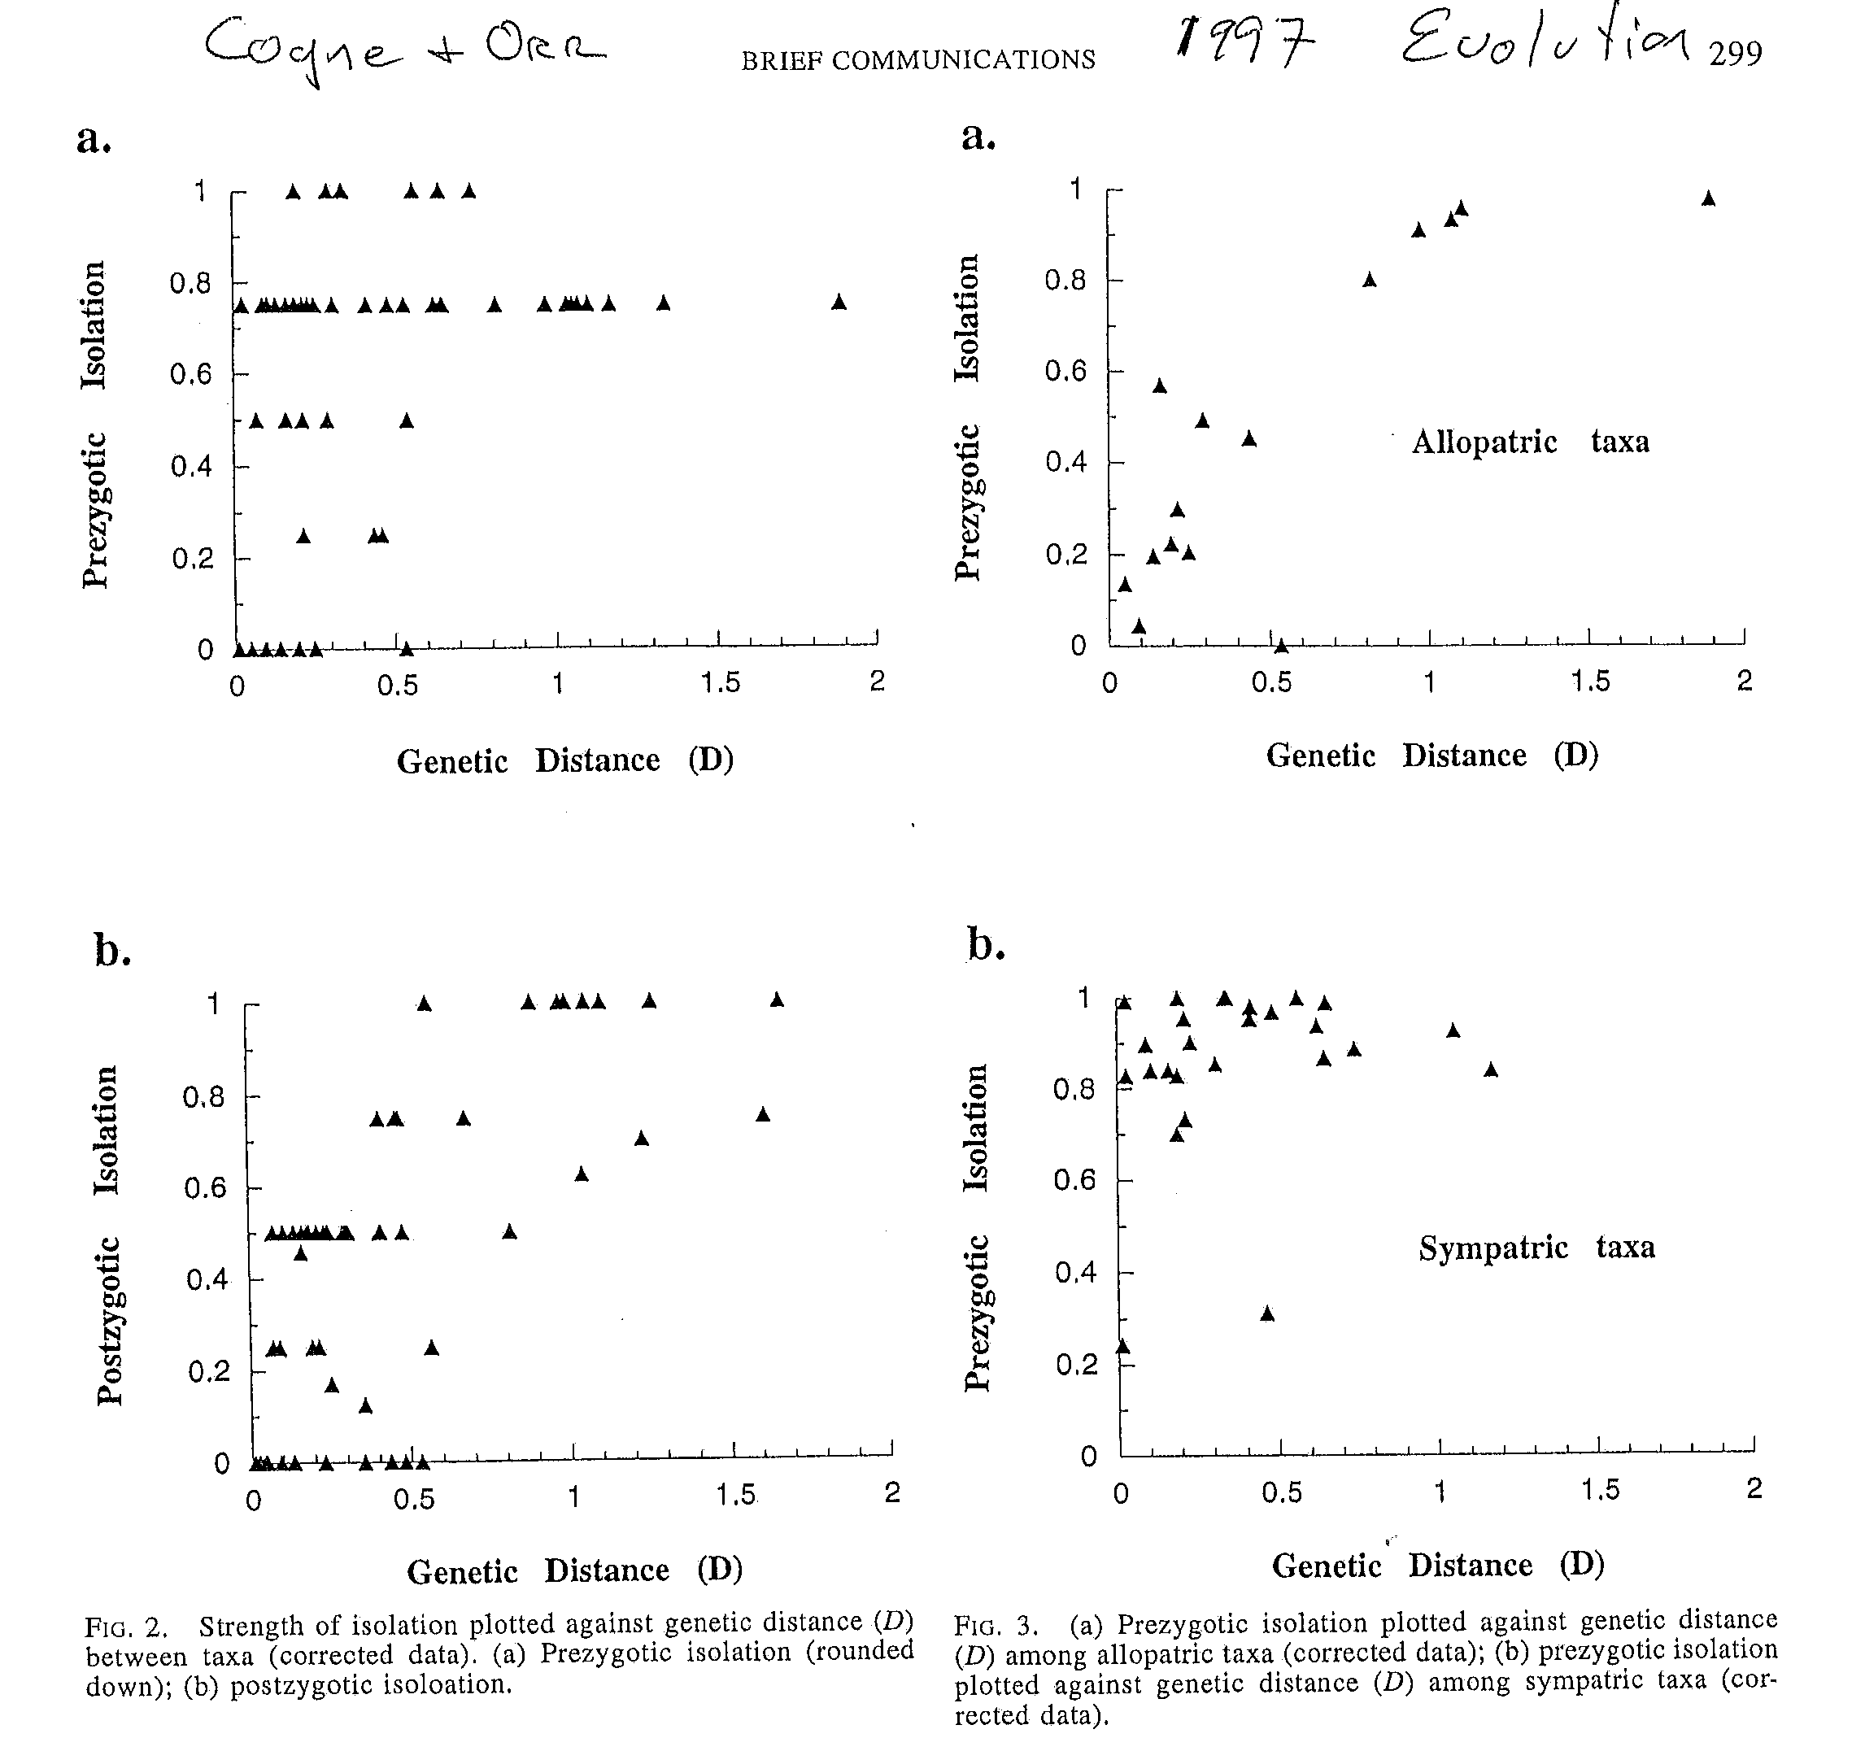
Postzygotic Isolation: Hybrid offspring are sterile or infertile

Slide 34
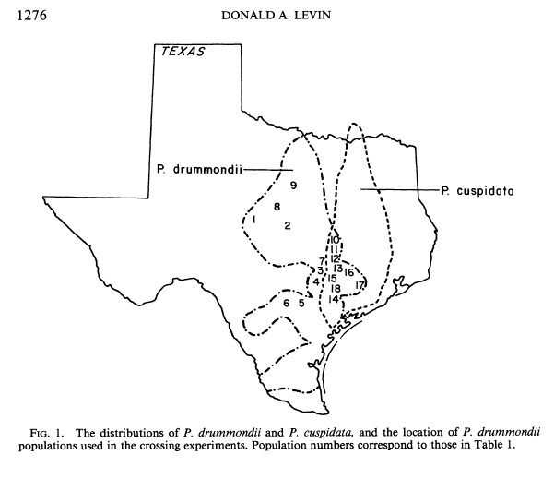
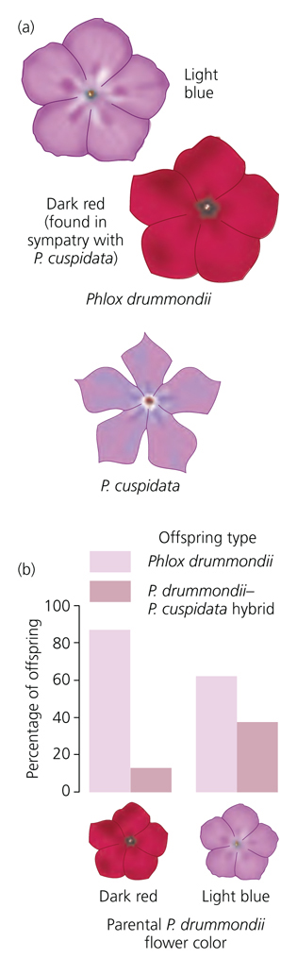
Reproductive Character Displacement in Phlox leads to Prezygotic Isolation
(Levin, Hopkins, Rausher)

Slide 35
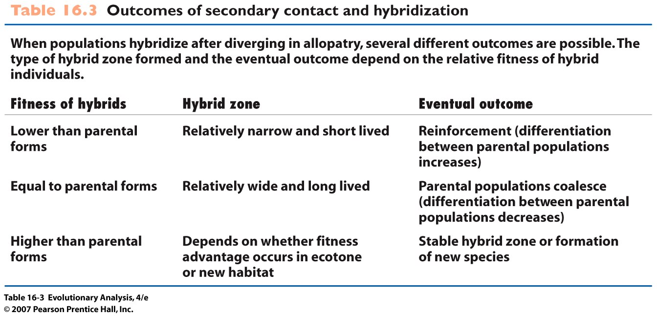
But other outcomes can occur
Notes:
Table 16.3 Outcomes of secondary contact and hybridization

Slide 36
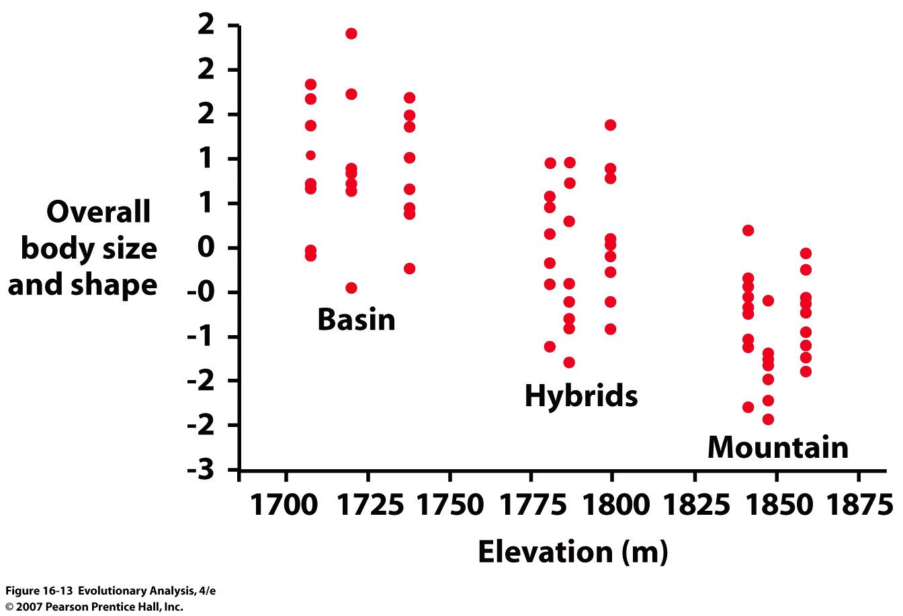
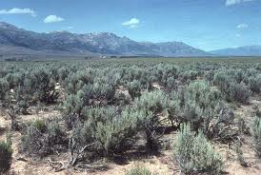
Hybrid sagebrush are intermediates of parental subspecies
Notes:
Figure 16.13 Hybrid sagebrush are intermediate in form between parental subspecies
On this graph, a quantity called the principal component score is plotted against the elevation where sagebrush plants were sampled. Principal component analysis (PCA) is a statistical procedure for distilling information from many correlated variables into one or two quantities that summarize the variation measured among individuals in the study. In this case, Carl Freeman and colleagues (1991) measured a large series of morphological traits in sagebrush such as height, circumference, crown diameter, and branch length. The PCA was performed to combine these many variables into a single quantity, the PCA score, that summarizes overall size and shape. Each data point represents an individual.

Slide 37
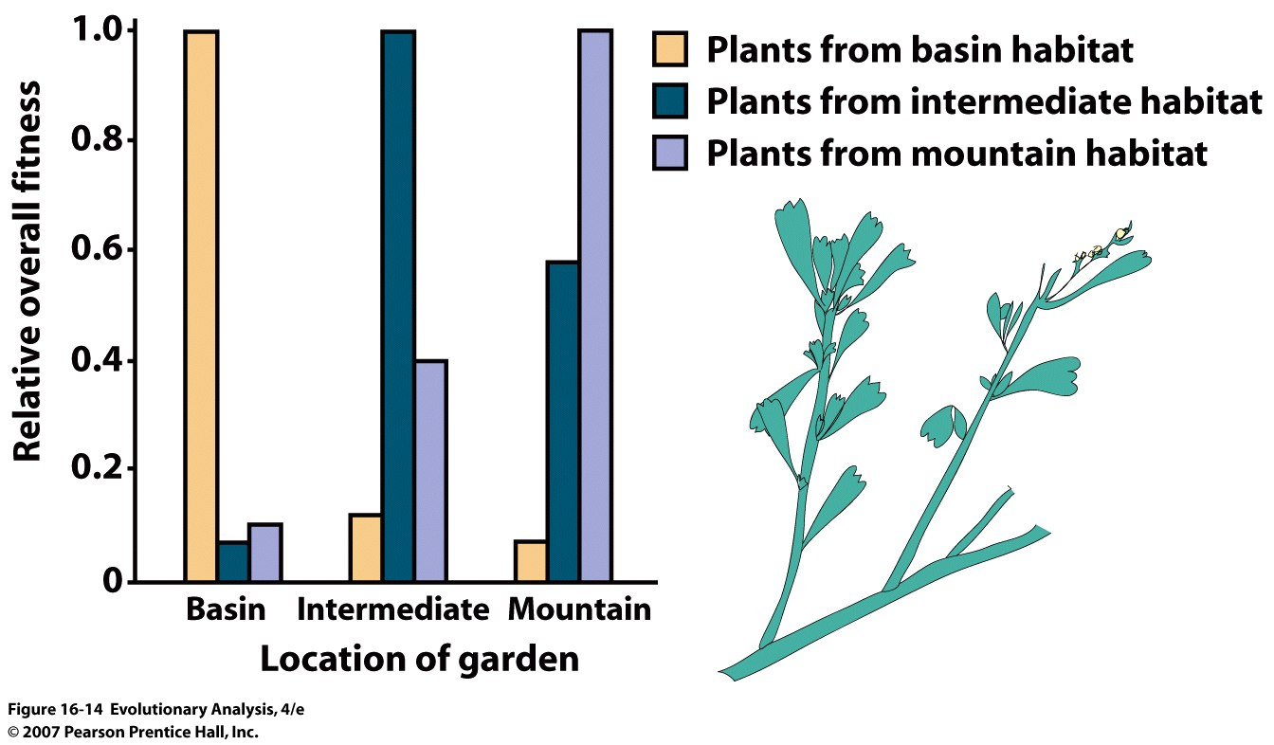
Relative fitness of big sagebrush taxa
Notes:
Figure 16.14 Relative fitness of big sagebrush taxa
The vertical axis on this graph plots an overall measure of fitness that combines data on survivorship, flowering, seed production, and seed germination rate. The data are expressed as relative fitness by assigning a value of 1.0 to the group that had the highest fitness in each of three experimental gardens and then expressing the fitness of the other groups as a percentage of that group's fitness. The horizontal axis indicates whether the data come from gardens at the basin, intermediate, or mountain elevations. From Wang et al. (1997).

Slide 38
Conclusion
Species definitions (BSC, DSC, PSC)
Origins of Species (allopatry, sympatry, chromosomal mutations, drift, sexual selection)
Evolution of isolating barriers
Consequences of hybridization

